Slide 1
LECTURE 06: INTERACTION
October 18, 2016
SDS136:
Communicating with Data

Slide 2
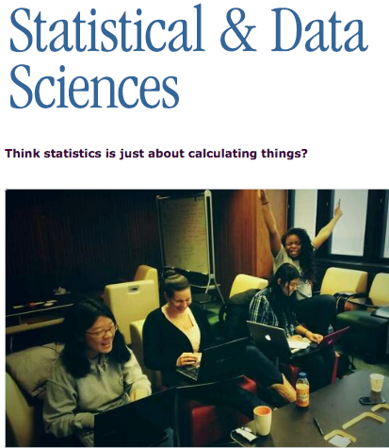
Announcements 1/2
Presentation of the Major & Minor
Wednesday @ lunch
Ford Hall
Seasons Room
FREE FOOD!

Slide 3

Announcements 2/2
October 19th is the last day to register to VOTE in MA
If you are:
a citizen of the United States
18+ years old (or will be by Nov. 8th)
a resident of Massachusetts
have a MA state-issued ID*
https://www.sec.state.ma.us/ovr

Slide 4
Outline
Interaction: a definition
Interaction with data and problem space
Relationship between interaction and understanding
Roles interaction plays
Interaction with visual interfaces
Basic interaction types
Sample interaction methods
Lab: coordinated multiple views

Slide 5
Interaction (def.)
Methods by which humans create knowledge through the manipulation of an interface
Low level: between human and interface
the set of operations available
the relationship between the human and the visualization
High level: between human and problem space
a cognitive act enabled by the tool
does not need to take place exclusively within them
might be distributed across multiple tools

Slide 6
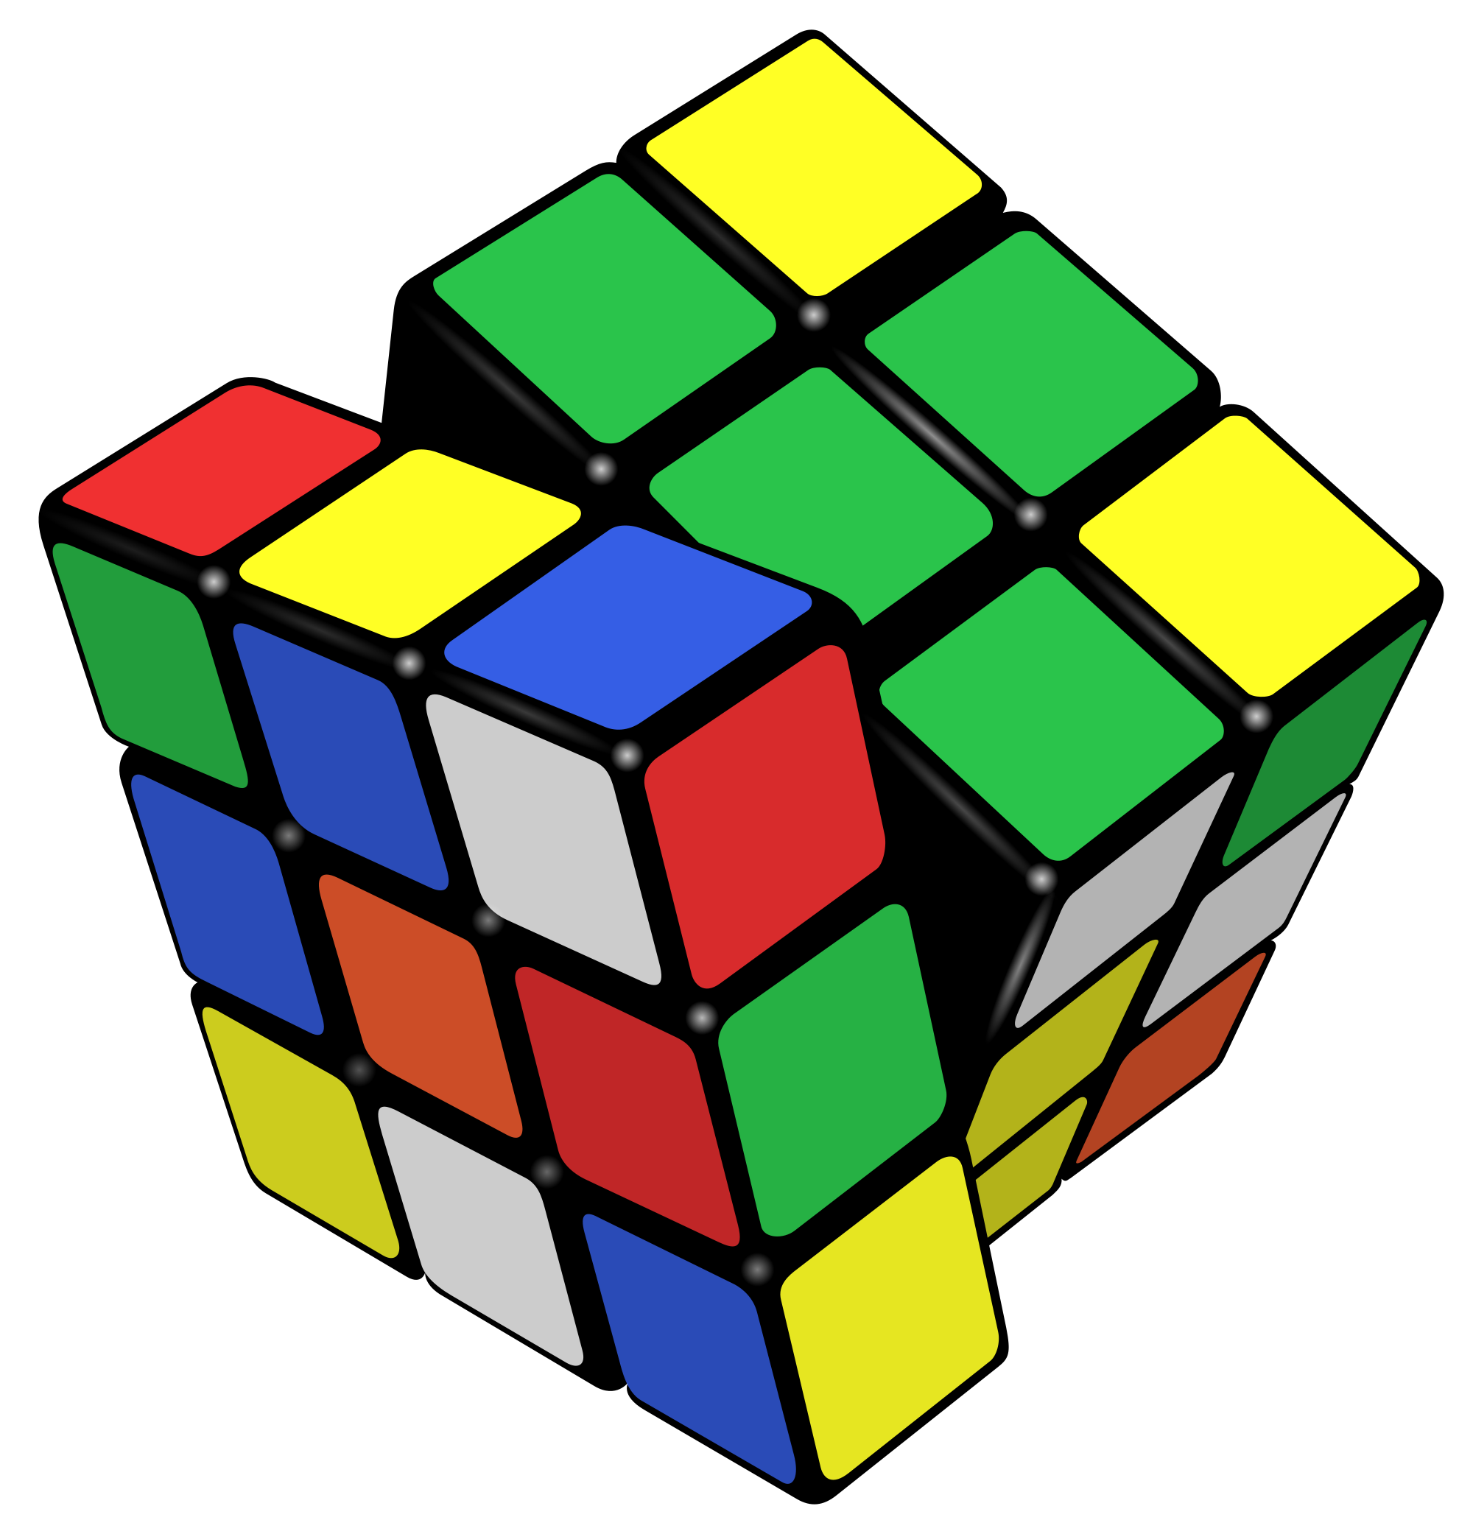
Example: Rubik’s Cube
What low-level interactions can you have?
What high-level interactions can you have?

Slide 7
Part I: High Level
Interaction with
Data / Problem Space

Slide 8
Interaction and analysis
Interaction is the observable result of a cognitive process: “an externalization of thought”
In visualization, there is a growing belief that interaction and analysis are actually the same thing!
Analytic discourse: the idea that knowledge is constructed, tested, refined, and shared through the interactive manipulation of an interface¹
¹Pike, W. A., Stasko, J., Chang, R., & O'Connell, T. A. (2009).
The science of interaction. Information Visualization, 8(4), 263-274.

Slide 9
Interaction as a reasoning aid
Interaction happens in the context of a problem or goal-directed activity
This context helps the human identify relevant concepts and link them into appropriate structures
Interaction brings together background contexts and current observations
This is known as “situated cognition”

Slide 10
Pragmatic vs. Epistemic Action
Pragmatic actions move a person and their analysis closer to the desired destination
Epistemic actions enable humans to leverage environmental structures to link internal structures
The purpose of some actions is not for the effect they have on the environment but for the effect they have on the humans

Slide 11
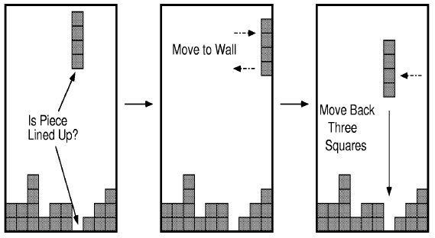
Example: Tetris Behavior

Slide 12

Discussion
True or false:
Hypothesis: the more ways a user can ‘touch’ their data (by changing their form or exploring them from different perspectives), the more insight will accumulate.

Slide 13
Interaction as distributed cognition
Visualization is often used as a tool to “offload” storage or computation from the human’s brain
In order for this to be useful, we have to be able to “reload” parts of the data and operate on it
This can be done through both internal (in your head) vs. external (on the screen) representations

Slide 14
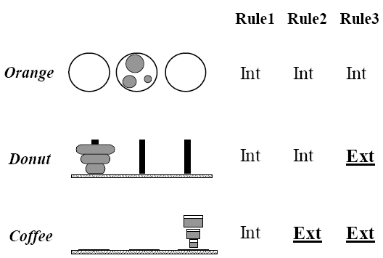
Example: Tower of Hanoi
Only one disk can be transferred at a time.
A disk can only be transferred to a pole on which it will be the largest.
Only the largest disk on a pole can be transferred to another pole.

Slide 15
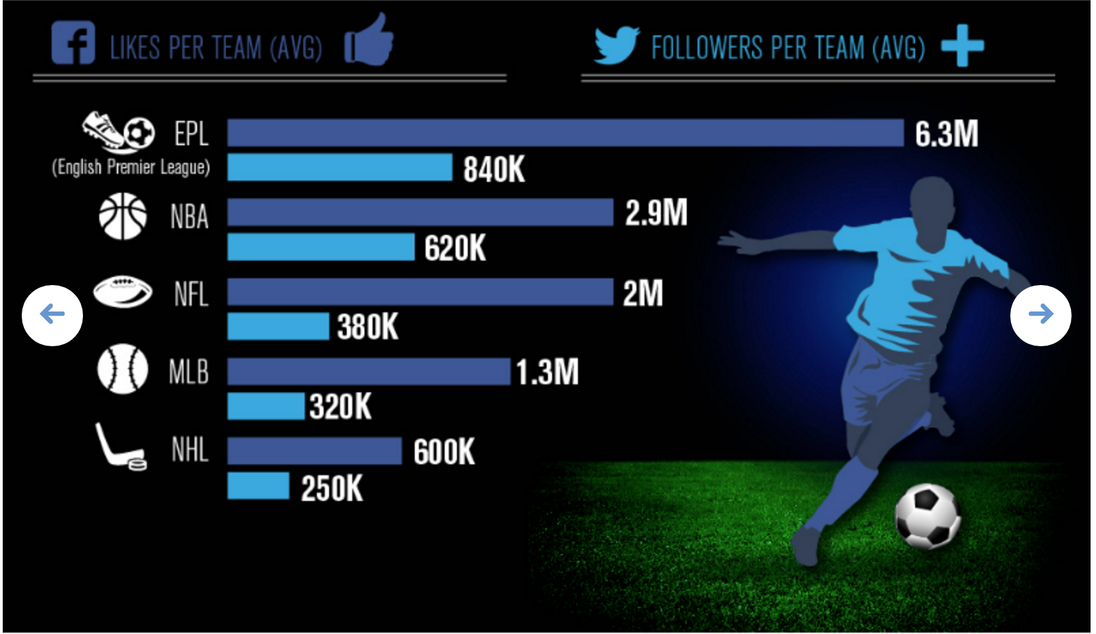
Flashback: #badvis
What representations are internal vs. external?

Slide 16
Suggested questions to ask when designing
What is the goal of the analysis?
Decision-making
Better understand a domain or a problem
Identify the trends of a phenomenon
Forecast the future
…etc.
What kinds of operations do we need to enable?
How can the visualization support those operations?

Slide 17
Part II
Interaction with
a Visual Interface

Slide 18
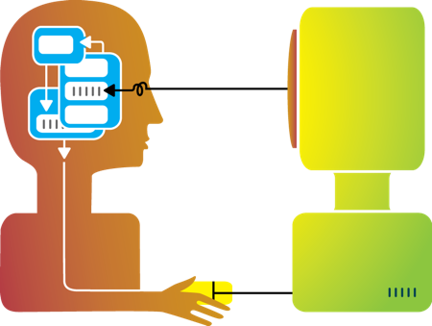
So far…
Visualization

Slide 19
Flashback: interaction as a reasoning aid
Interaction is situated in the context of a problem or goal-directed activity
Question: what kinds of things might someone want to do using a visualization?

Slide 20
Yi, Kang, Stasko and Jacko (2007)
Select: mark something as interesting
Explore: show me something else
Reconfigure: show me a different arrangement
Encode: show me a different representation
Abstract/Elaborate: show me more or less detail
Filter: show me something conditionally
Connect: show me related items
Select: mark something as interesting
Explore: show me something else
Reconfigure: show me a different arrangement
Encode: show me a different representation
Abstract/Elaborate: show me more or less detail
Filter: show me something conditionally
Connect: show me related items
Yi, J. S., ah Kang, Y., Stasko, J. T., & Jacko, J. A. (2007). Toward a deeper understanding of the role of interaction in information visualization. Visualization and Computer Graphics, IEEE Transactions on, 13(6), 1224-1231.

Slide 21
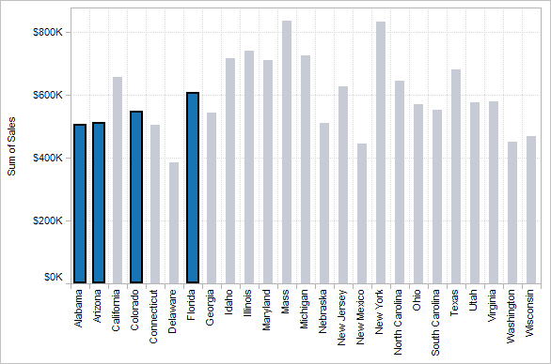
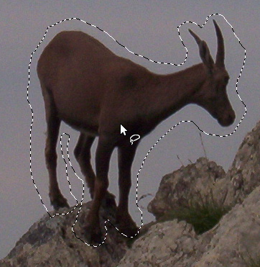

1. Select
Mark something as interesting: direct

Slide 22
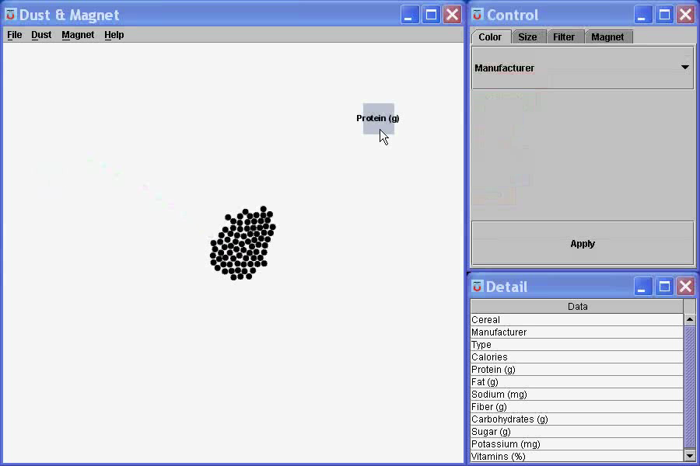
1. Select
Mark something as interesting: indirect
Notes:
What are you selecting? One item at a time?
Selecting of a value?
Selecting of a range?
Selecting of a position on the screen?

Slide 23
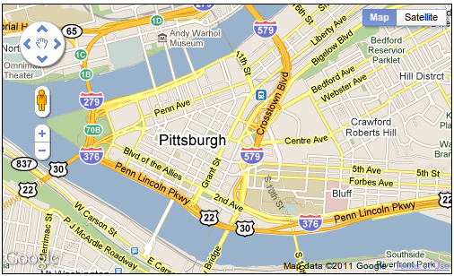
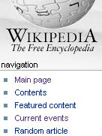
2. Explore
Show me something else
Scroll bars
Panning
Direct-Walk (e.g. hyperlink traversal)

Slide 24
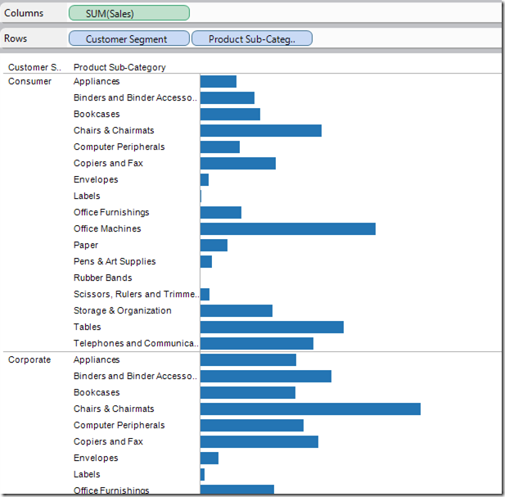
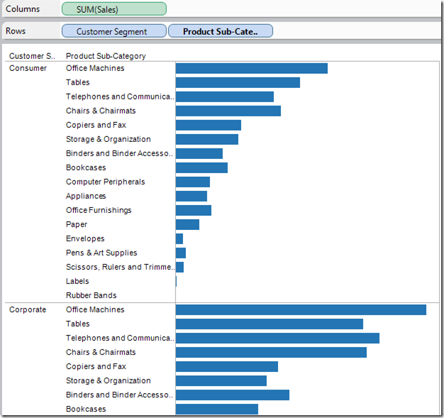
3. Reconfigure
Show me a different arrangement: sorting

Slide 25
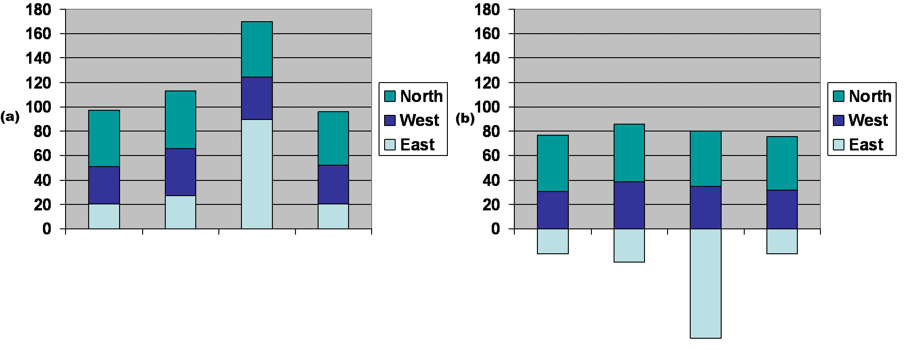
3. Reconfigure
Show me a different arrangement: baseline adjustment

Slide 26
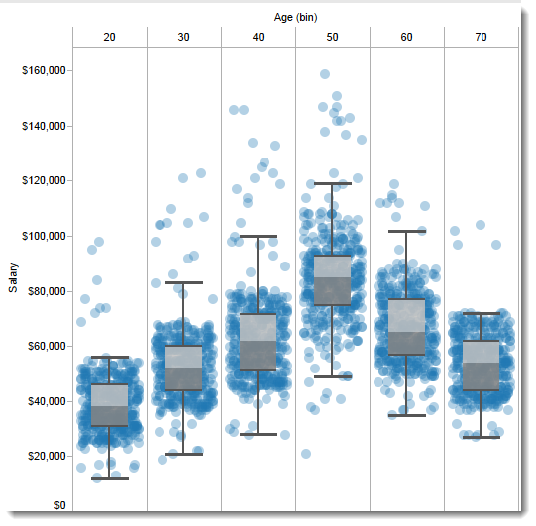
3. Reconfigure
Show me a different arrangement: reduce occlusion (jitter)

Slide 27
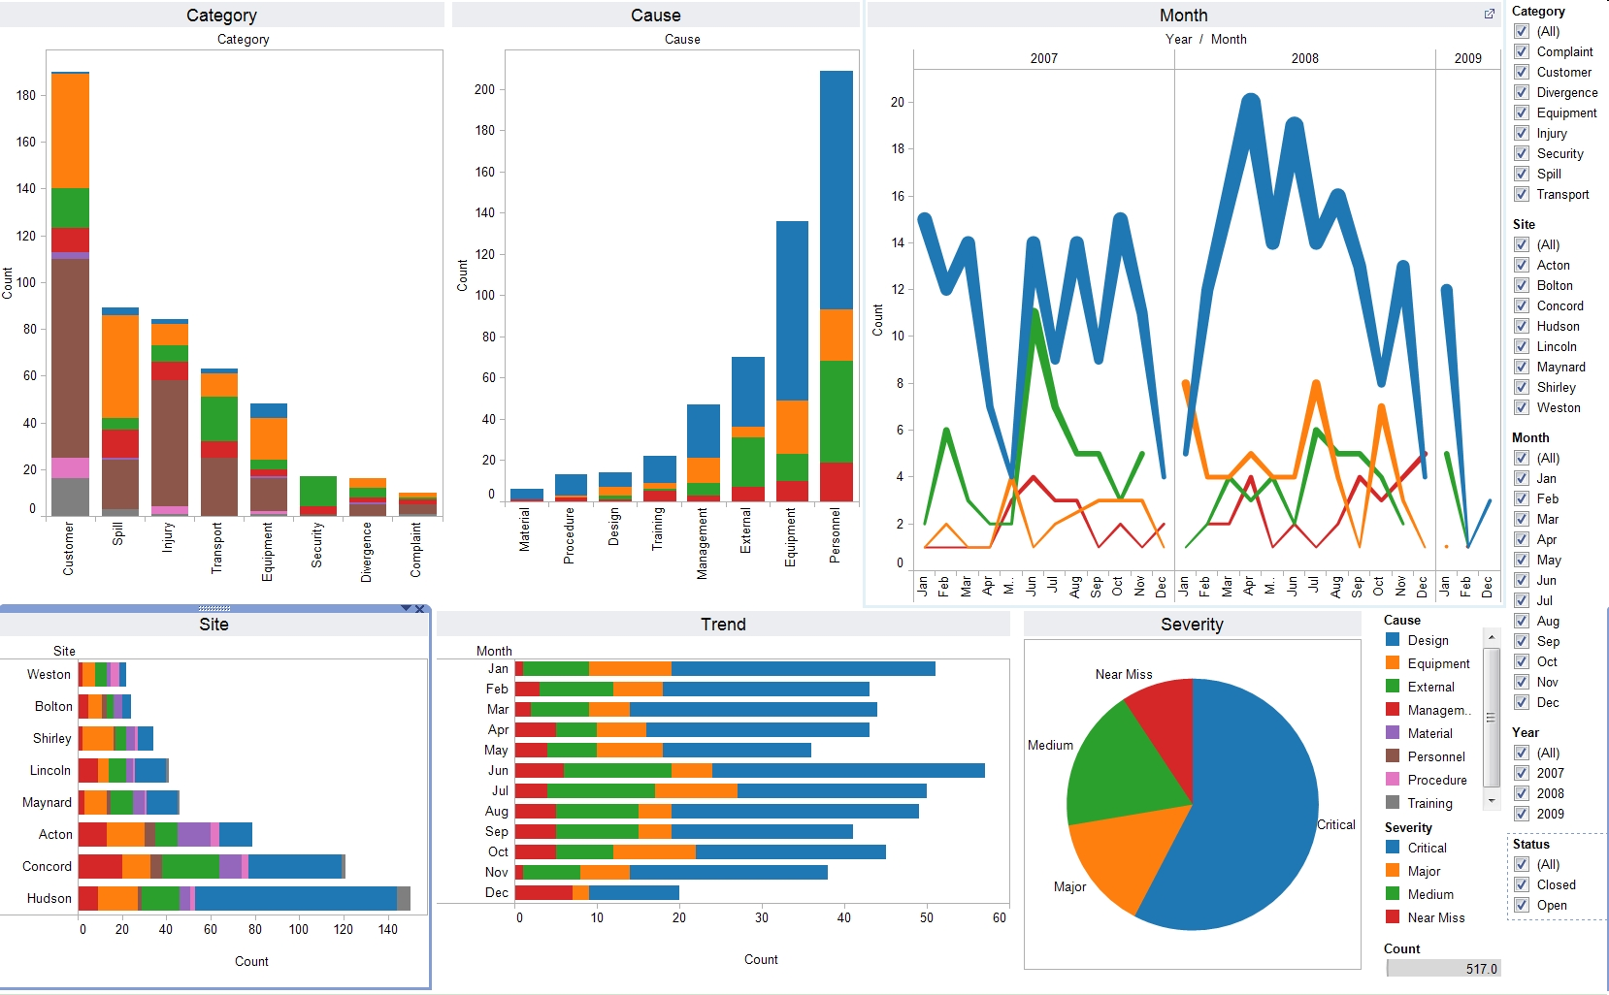
4. Encode
Show me a different representation: visualization type, color, size, orientation, etc.

Slide 28
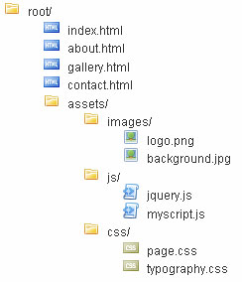
5. Abstract / Elaborate
Show me more or less detail: drill up/down

Slide 29
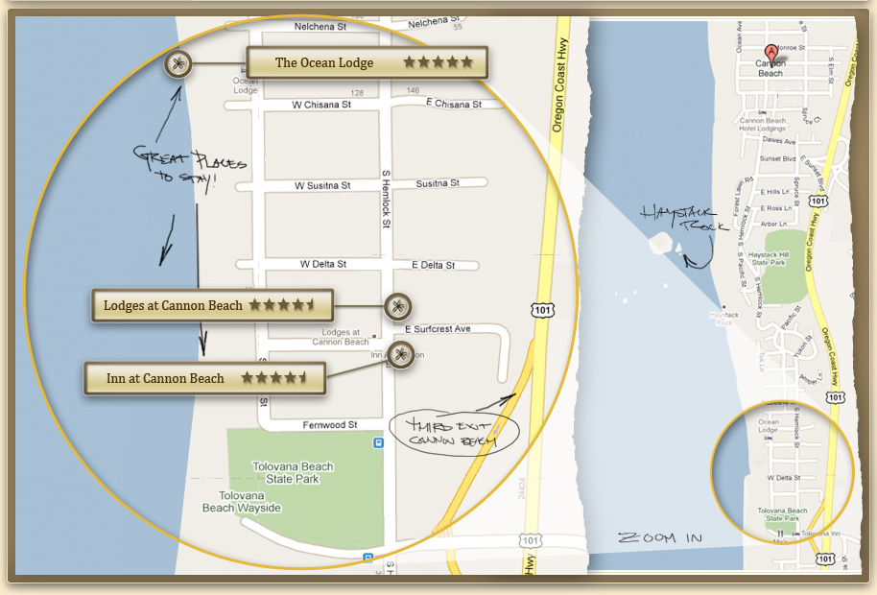
5. Abstract / Elaborate
Show me more or less detail: zooming

Slide 30
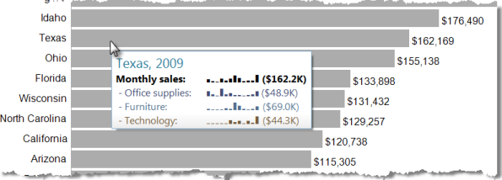
5. Abstract / Elaborate
Show me more or less detail: tooltips

Slide 31
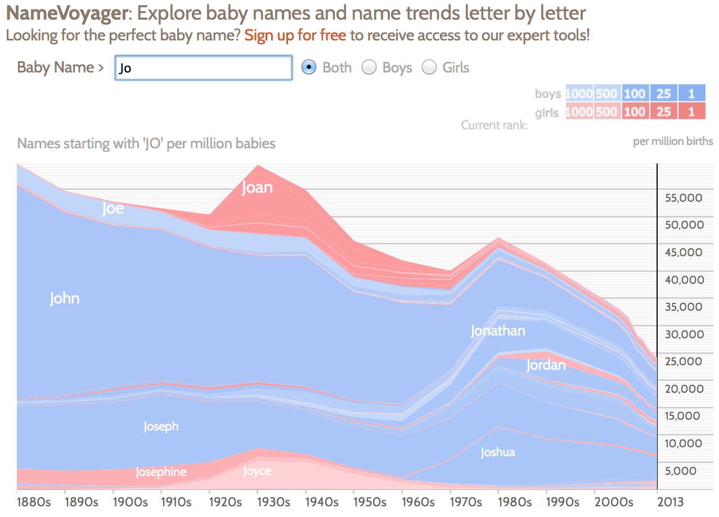
6. Filter
Show me something conditionally

Slide 32
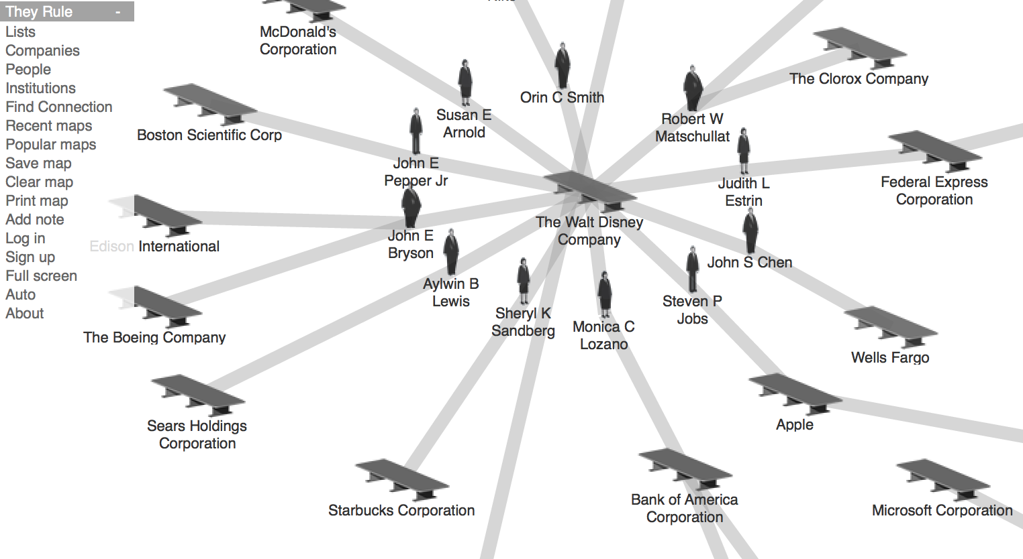
7. Connect
Show me related items: build-out

Slide 33
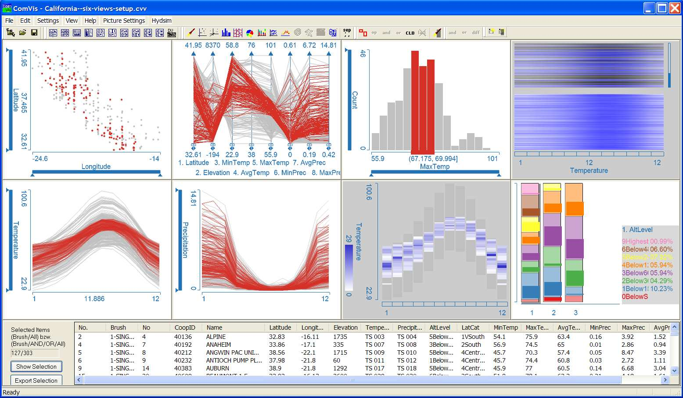
7. Connect
Show me related items: coordinated multiple views (CMV)

Slide 34
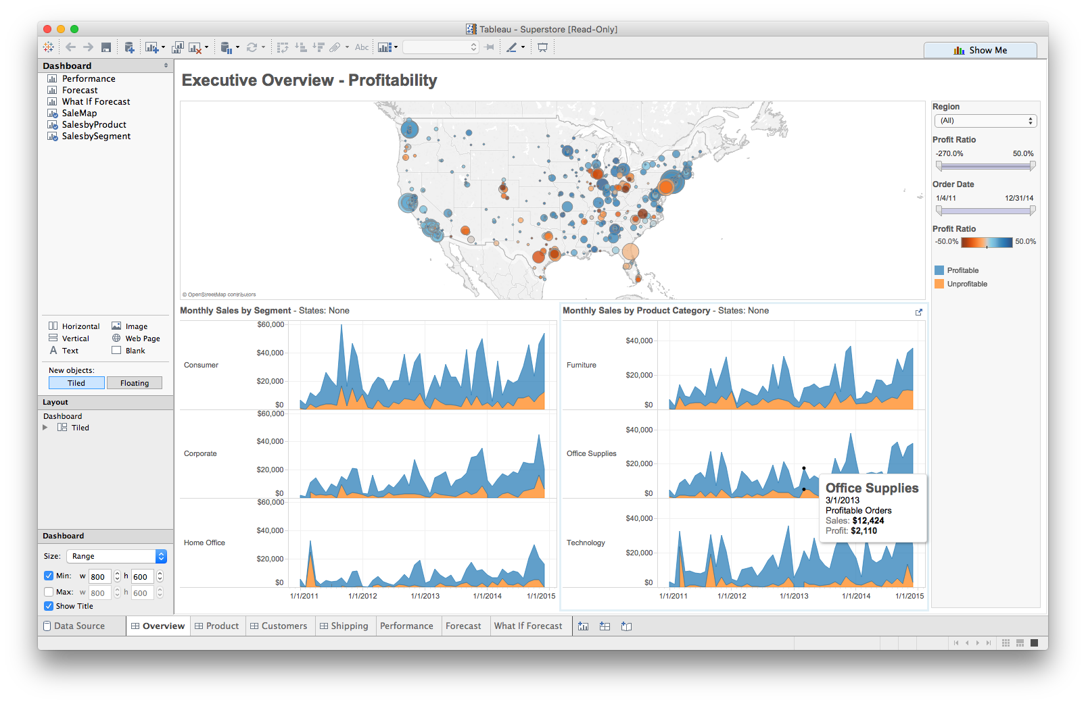
Multiple views
Different
representations
Different
data
Systems that use two or more distinct views
to support the exploration of a single concept or domain

Slide 35
When to use multiple views?
The data is too big
Lots of attributes
Lots of observations
The data is too complicated
Lots of data sources
Lots of data types
The data has several interesting parts, but no one visualization highlights them all

Slide 36
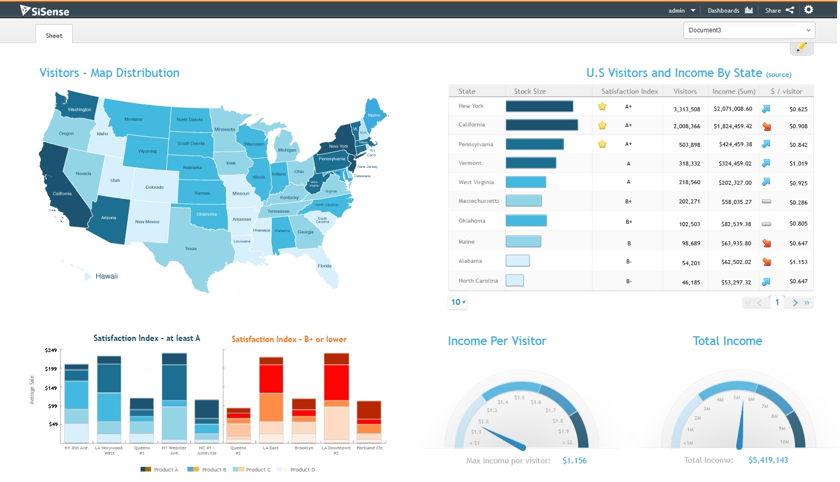
Need to think about: resource optimization

Slide 37
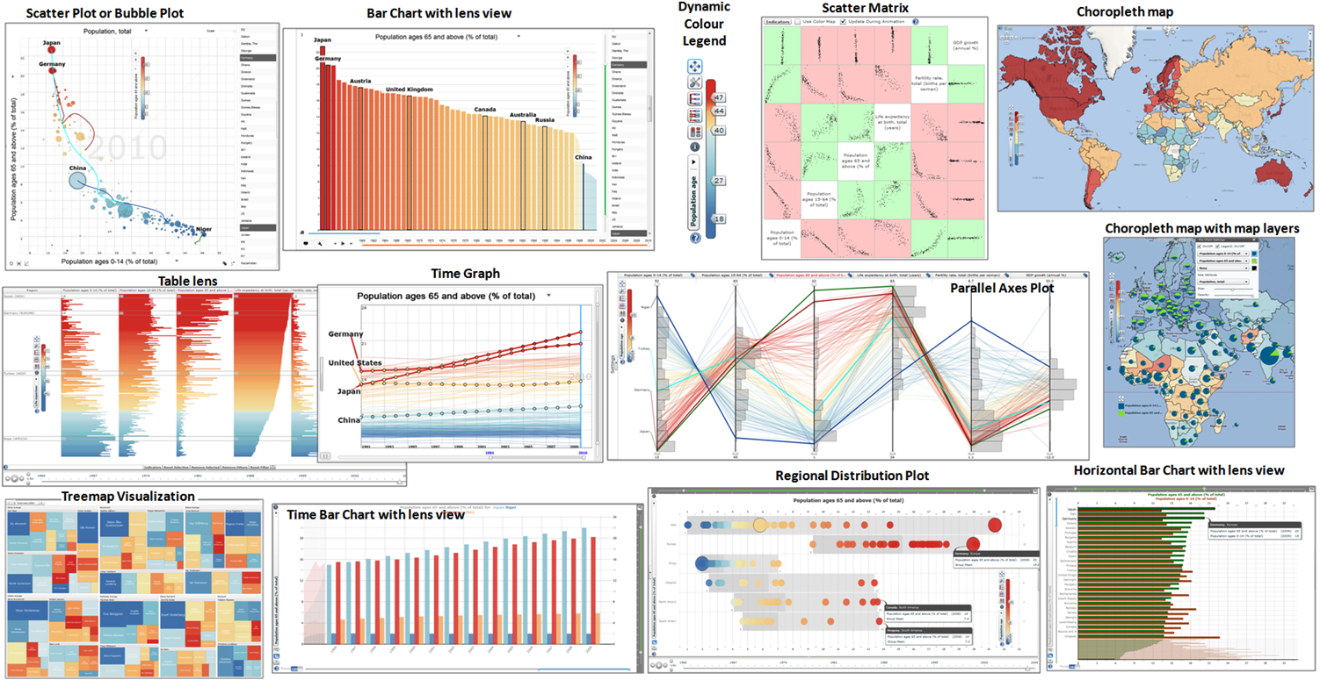
Need to think about: resource optimization

Slide 38
Guidelines for multiple views
Balance the costs of presenting multiple views with the benefits of using the views
Split complex data into multiple views to create manageable chunks
Use views that are complimentary, bringing out correlations and/or disparities
Use perceptual cues to:
make relationships more apparent to the reader
focus the reader’s attention on the right view at the right time

Slide 39
Coordination: brushing and linking
Big idea: actions in the real world have ripple effects; actions on a visualization should too
Brushing: the visualization responds (usually through highlighting) as a person “brushes past” data points
Linking: the visualization connects related data points across multiple views

Slide 40
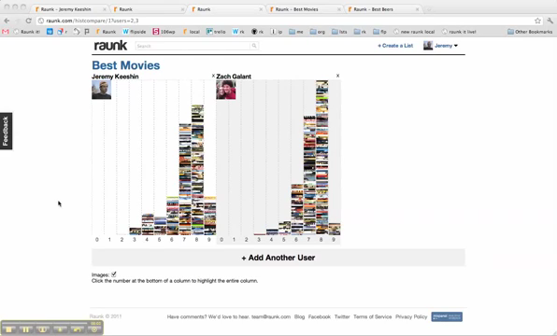
Coordination: brushing and linking

Slide 41
Coordinated multiple views
Multiple views + brushing and linking
Big idea: propagate interaction from one view to all others, respond as appropriate

Slide 42
Discussion
What would we need to make this work?

Slide 43
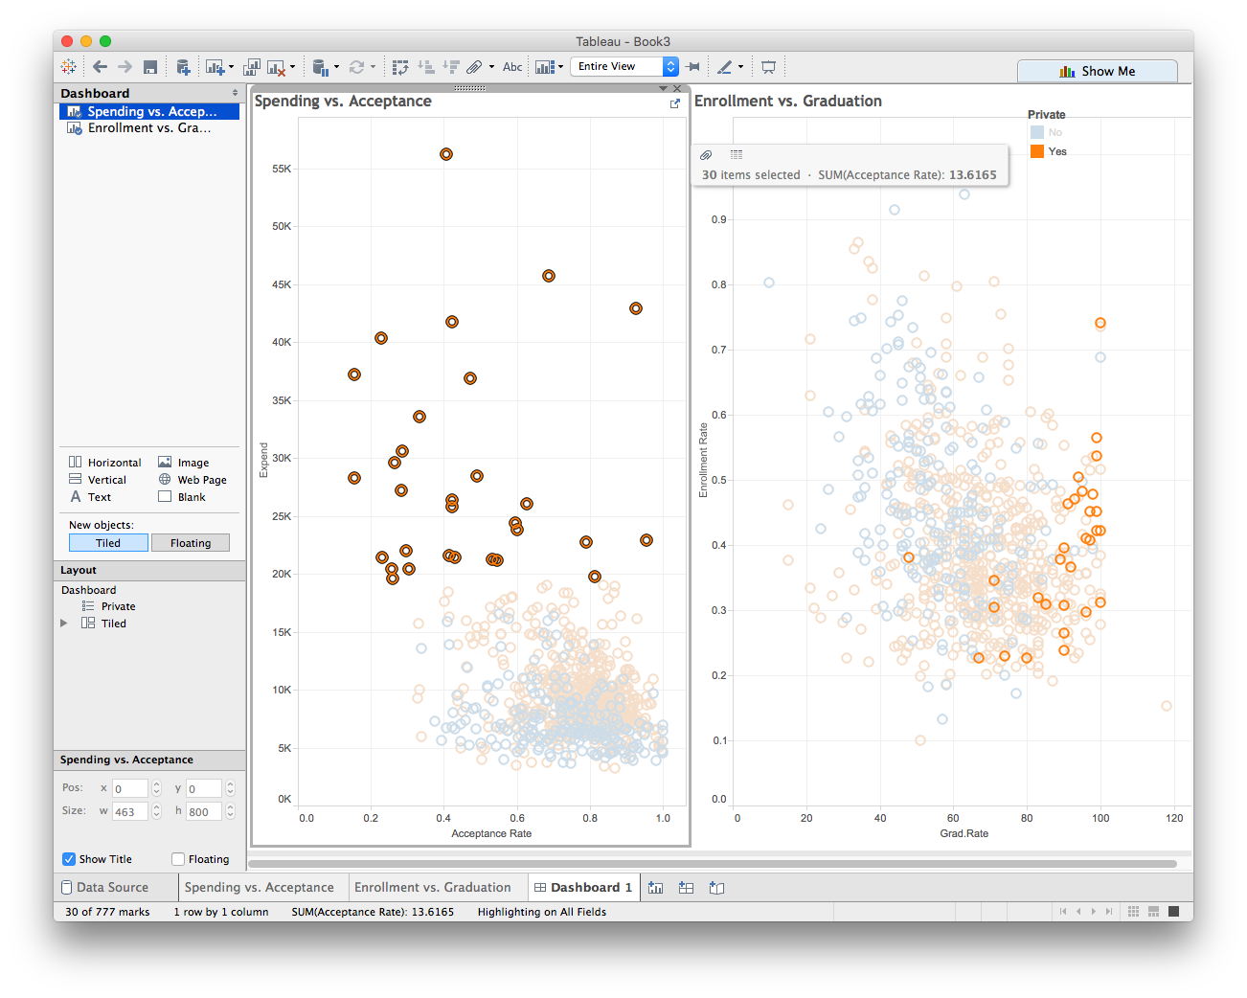
Walkthrough: working with actions

Slide 44
Lab 5: coordinated multiple views
Instructions for today’s lab are available at:
http://www.science.smith.edu/~jcrouser/SDS136/labs/lab5
This is the first of several open-ended labs, where you get to decide what to visualize and how
It’s okay if you get stuck! Just ask for help ☺
To get credit for this lab, publish your visualization to Tableau Public and post a link to Piazza

Slide 45
Up next
Geographic Visualization

